Slide 1
Who really invests in CEE?
Magdolna Sass, MTA KRTK and BGE

Slide 2
Outline
Background
Theory and empirics
Data
Statistical and econometric analysis
Conclusion

Slide 3
Background
Changes in the world economy in the last 2-3 decades: increased use of third (fourth etc.) countries by MNCs in their foreign direct investments, creation of „chains of FDI” or FDI networks
Increased use of intermediary countries – Why? The purposes of MNCs can be different:(Kalotay, 2012):
Tax optimisation or tax avoidance, through using tax havens or quasi tax havens,
Establishment of regional headquarters or regional hubs,
Structural reorganisation of the MNC network with efficiency, tax or legal purposes (2016; GE),
Concealing the real origin of the MNC (mainly emerging, BRICS)
Round-tripping and transhipment issues in newly liberalised, politically instable states (e.g. Chinese or Russian FDI)
It is less and less clear who really invests in a country.

Slide 4
Owners of top Hungarian companies (sales)
 | Name of the company | Immediate owner | Final owner | Sales (million HUF)
1 | MOL Magyar Olaj- és Gázipari Nyrt. | Dispersed (stock exchange), majority foreign; largest: Hungarian and Czech | dispersed | 3553005
2 | Audi Hungária Motor Kft. | Hungarian (until end-2016) | German | 2349346
3 | Bosch-csoport | German | German | 1184565
4 | Mercedes-Benz Manufacturing Kft. | German | German | 1058340
5 | Magyar Villamosművek Zrt. | German | German | 1058340
6 | GE Infrastructure Holding Kft. | Swiss | US | 895508
7 | Magyar Suzuki Zrt. | Japanese | Japanese | 710252
8 | Tesco Global | Luxemburg, UK | UK | 636234
9 | Magyar Telekom | Dispersed (stock exchange), largest: German | German | 602651
10 | Flextronics | Austrian, Hungarian | Singapore/US | 590464
Sources: Figyelő TOP 200, 2017, balance sheets of companies

Slide 5
Why is it important who really invests in a country? Theory and empirics
Locational advantages (OLI-framework): L-advantages are important in relation to home and host countries and third countries; plus in interaction with O and I advantages
(Real) home country impacts (export, production structure, BOP, technology, knowledge, economic policy etc., e.g. Kokko, 2006)
Host country impacts depend on the (real) home country’s various characteristics (regulations, economic policies, business and HR culture etc., not many studies but empirical evidence for various countries, e.g. Wang, Clegg, Kafouros, 2009 for China; Hennart, Larimo, 1998 (cultural distance impact on ownership); Chen, 2011: impact on firm performance)
Impact on the intermediary country – not analysed yet

Slide 6
Data
Up till recently: BOP FDI data published on immediate or direct investing country
New databases: BPM6 and BMD4 (IMF, OECD) – data on the ultimate controlling investor’s country
Problems with the new databases:
Available for a few countries only from OECD (CEE: Czech Rep., Estonia, Hungary and Poland; OECD: USA, Switzerland, and Italy);
Certain countries’ national banks publish preliminary data (Austria, France, Germany, UK)
Maximum 3 years covered (2014, 2015 and 2016)
For inward FDI only (no mirror comparison);
Controlling owner (with above 50 % total ownership share) – some FDI is lost;
Problematic cases are assigned to the immediate investor.
But still: interesting insights into who really invests in your country

Slide 7
Key concepts
Indirect FDI: Indirect FDI means the utilization of affiliates abroad as intermediaries for investment in third countries.
Roundtripping: Capital channelled abroad by resident investors and returned to the domestic economy in the form of FDI.
(Transshipment: inclusion of a third (or further) country between the home and host countries of FDI – basically equals indirect)
Creation of ownership-chains – double, triple or more counting of FDI (as in foreign trade due to GVCs – TiVA, WIOD databases)

Slide 8
Who really invests in CEE: CZ, HU, PL, 2016 (million USD): Top 10 investors

Slide 9
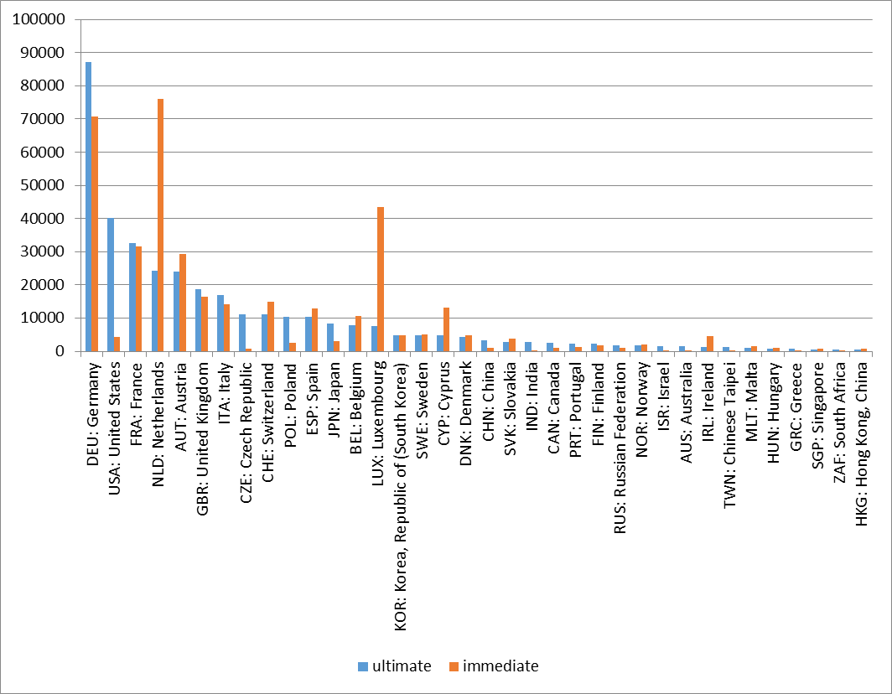
Who really invests in CEE: CZ, HU, PL, 2016 (million USD)

Slide 10
Who really invests in CEE?
Germany is by far the most important, partly indirectly
US: much more important, mainly indirectly
More even distribution (based on ultimate) for other EU-members (esp. France, Netherlands, Austria, UK, Italy, Switzerland, Spain)
Higher share of extra-EU: especially Japan, China, India, Chinese Taipei (Korea: no)
Higher share of CEE regional FDI (except for Hungary: intermediary country), but main reason: roundtripping
Minor, but higher share than immediate: Canada, Russia, Australia

Slide 11
Who has not invested so much in CEE compared to what we thought previously?
Certain EU-members, (not outside-EU offshore centers) especially:
Netherlands („Dutch sandwich”) (CZ, HU, PL)
Luxemburg (CZ, PL)
Austria (mainly HU)
Ireland („Irish double”) (HU, PL)
Less important: Belgium, Cyprus (Russian FDI, especially PL)

Slide 12
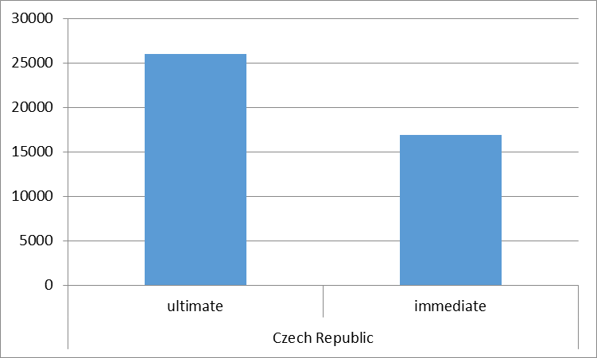
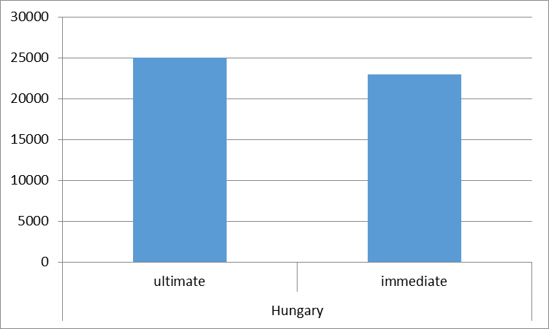
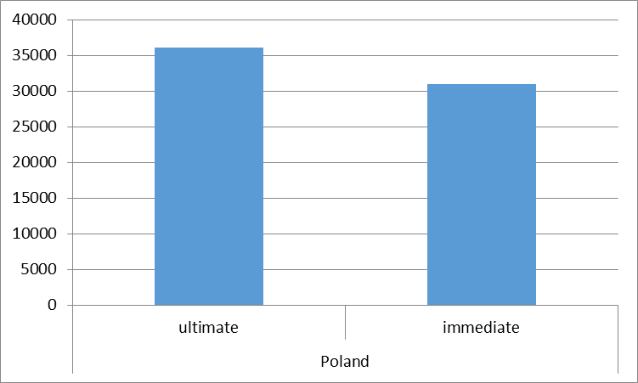
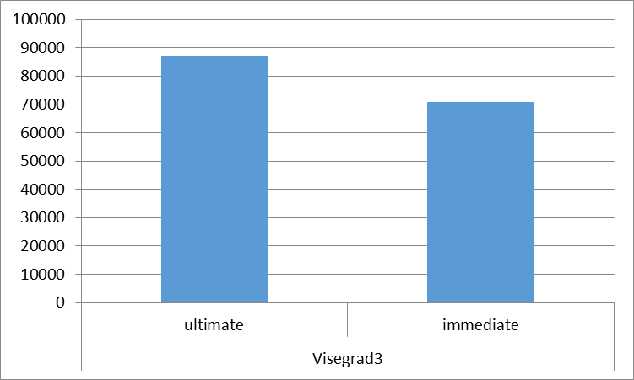
Country case: Germany
Mainly directly, but 16 billion USD indirectly (18%), esp. CZ
For example in Hungary: Audi („Hungarian”) or Siemens (through Austria)
Motivation: mainly organisational

Slide 13
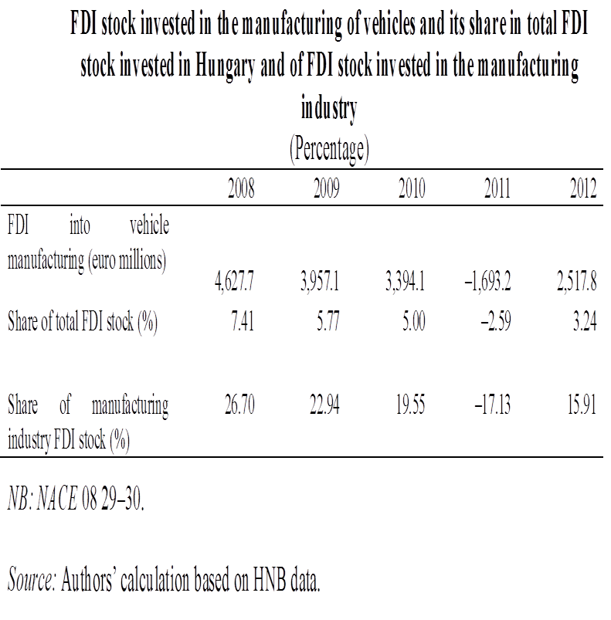
The case of Audi: turning Hungarian FDI statistics upside down
In November 2011, the sole owner, Audi AG of Germany apported the shares of its Hungarian subsidiary, Audi Hungária Motor Kft. into Audi Hungária Services Zrt (a business services firm)
Since January 2017: dissolution of the holding firm
(also OFDI statistics affected: to cover VW during crisis losses, the Hungarian Audi subsidiary bought shares in a Belgian VW subsidiary for 3 billion euros in 2012)

Slide 14
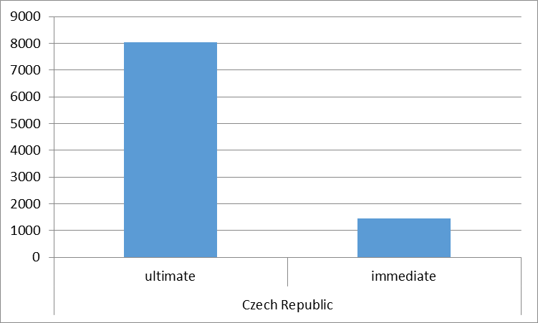
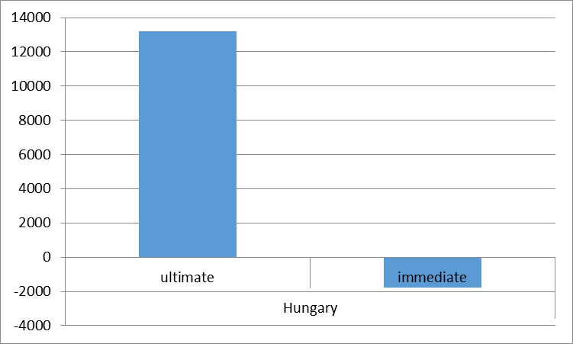
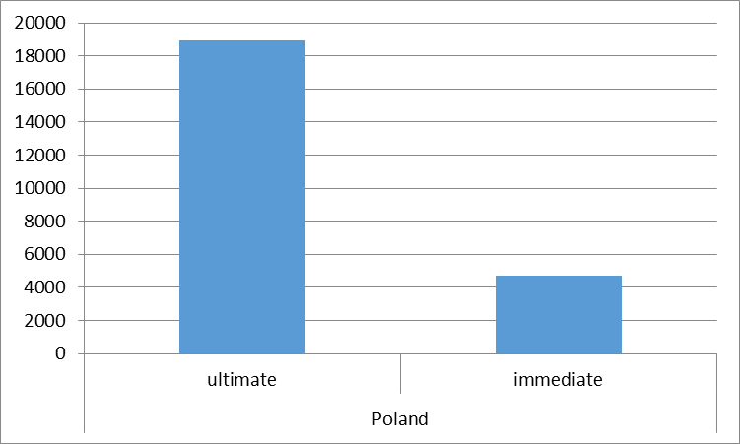
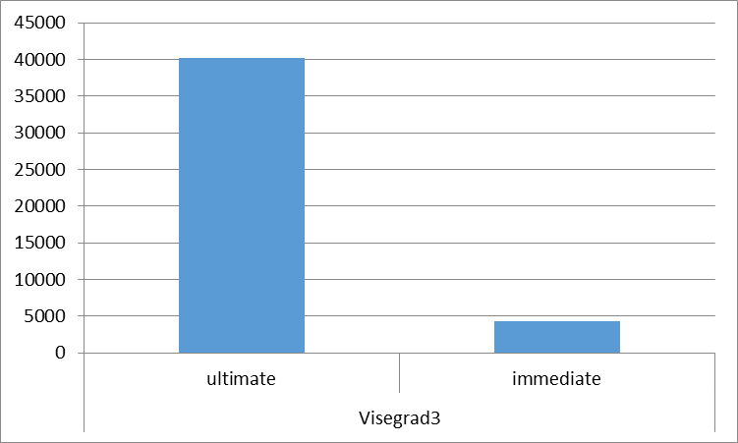
Country case:USA
Singificantly more important than according to immediate data
CZ: 4th, PL: 3rd, HU: 2nd investor country
Mainly indirectly: ultimate is almost tenfold of immediate
HU: only Budapest Bank was immediate
Motivation: organisational (European hub) or tax savings (Ireland, Netherlands, Luxemburg)

Slide 15
Explains the negative value for HU:

Slide 16
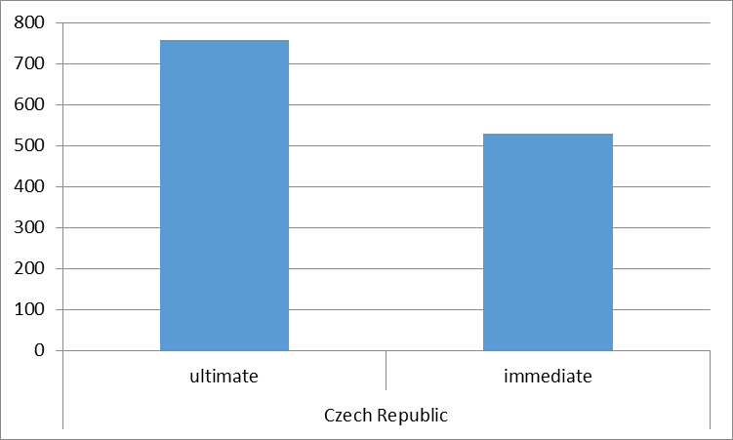
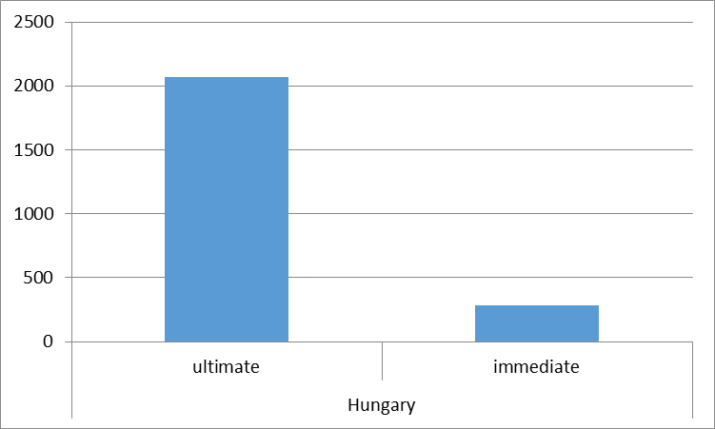
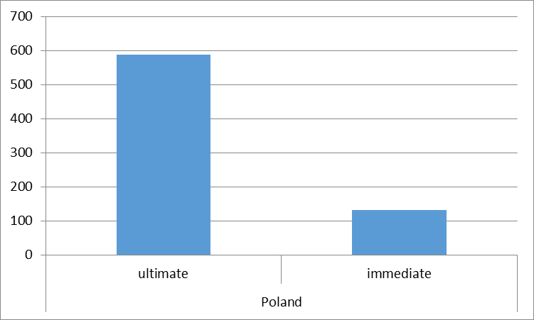
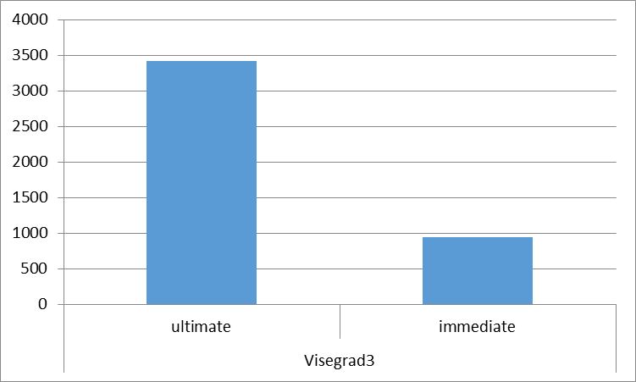
Country case: China
Outside Europe usually more important than according to immediate data
Certain FDI inherited through acquisitions of (Western) European parent companies (HU: Yanfeng, Borsodchem)
High concentration, higher risks compared to others
Motivation: tax optimisation (70% of Chinese OFDI goes directly to tax havens), concealing the real origin (Hong Kong relatively important), heritage

Slide 17
The case of Hungary: selected Chinese FDI projects

Slide 18
Roundtripping (when the ultimate owner is domestic)
Present in all 3 countries, extent different:
Czechia: 8.5 % (!) of total stock;
Poland: 4.5%
Hungary: 0.3%
(For comparison: for the „notorious” for roundtripping Russia: more than half of OFDI; in the US: 2%)
Indicative of the business environment and differential treatment of foreign and domestic actors?

Slide 19
„Real” share of EU FDI in CEE: much lower
Immediate: dominating
Ultimate: much lower: many outside-EU investors go through another EU country, when they invest in CEE
Especially low: Hungary – lower „FDI-dependence” on EU, though the majority extra-EU FDI destined to produce for/serve EU markets
 | immediate EU stock in total (%) | ultimate EU stock in total (%)
Czechia | 89.1 | 82.1
Hungary | 87.7 | 57.6
Poland | 92.2 | 68.5

Slide 20
Level of intraregional (intra-CEE) FDI: overall slightly lower (CZ higher, HU lower)
 | Immediate |  |  |  | Ultimate
 | Czechia | Poland | Hungary | V2 | Czechia | Poland | Hungary | V2
Czechia | 0 | 552.0 | 123.5 | 675.5 | 0 | 769.6 | 341.2 | 1110.8
Poland | 2119.2 | 0 | 255.9 | 2375.1 | 1836.9 | 0 | 267.4 | 2104.3
Hungary | 293.1 | 448.9 | 0 | 742.0 | 280.8 | 155.1 | 0 | 435.9

Slide 21
Econometric analysis (work in progress, preliminary)
A simple test (whether the ultimate controlling owner data perform better than the immediate) - Hungary
LnFDIstock (2016)= GDPhome+GDPpercapitahome+DISTcapitals + Dummy1(common border) + Dummy2 (EU)
Results with immediate FDI: Rsquared: 0.387, adj. Rsquared: 0.327; F: 6.439, significant variables: per capita GDP and EU
Results with ultimate FDI: Rsquared: 0.416, adj. Rsquared: 0.358; F: 7.258; significant variables: GDP, per capita GDP and EU

Slide 22
Conclusions and consequences for policy
Tax optimisation/evasion; restructuring of the network of MNCs, concealing the real origin of the investor etc. increased the share of FDI in total going through third (fourth, fifth etc.) countries
FDI breakdown data by nationality of investor, sector and activity yields decreasing amounts of useable information
It has become less and less clear who really invests in a country
Efforts of IMF and OECD to improve statistics, including FDI to reflect new economic realities
BPM6 and BMD4 provide a useful tool – new data according to the ultimate owner of FDI

Slide 23
According to the new data and to the comparison of immediate and ultimate owner nationality data
Differences in main investor countries (Germany, US dominates, and more „even” distribution among others, extra-EU overall higher; lower share of EU, esp. for HU and PL)
Certain EU-countries mainly „intermediates” (Netherlands, Luxemburg, Austria, Ireland)
Consequences for economic policy (influence of which country’s policies/changes in the business environment; considerations for FDI promotion etc.)
(International: fighting fiscal erosion due to tax optimisation may be easier than previously thought – as the concentration is quite high….)

Slide 24
Future research
Impact on intermediary countries (HU…)
Impact depending on real home countries
Motivations
Econometric models using data according to immediate and final/ultimate owner countries – work in progress; Other variables included (tax haven, HDI, relative measures of GDP, GDP per capita…)
Web of FDI with double, triple… counting in the world economy – TiVA-type approach?

Slide 25
Thank you for your attention!

Slide 26
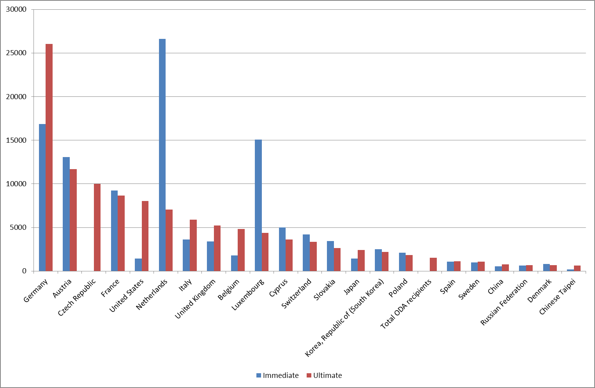
Immediate versus ultimate investors: Czech Republic (2016, million USD, OECD)

Slide 27
Immediate versus ultimate investors: Hungary (2016, million USD - HNB)

Slide 28
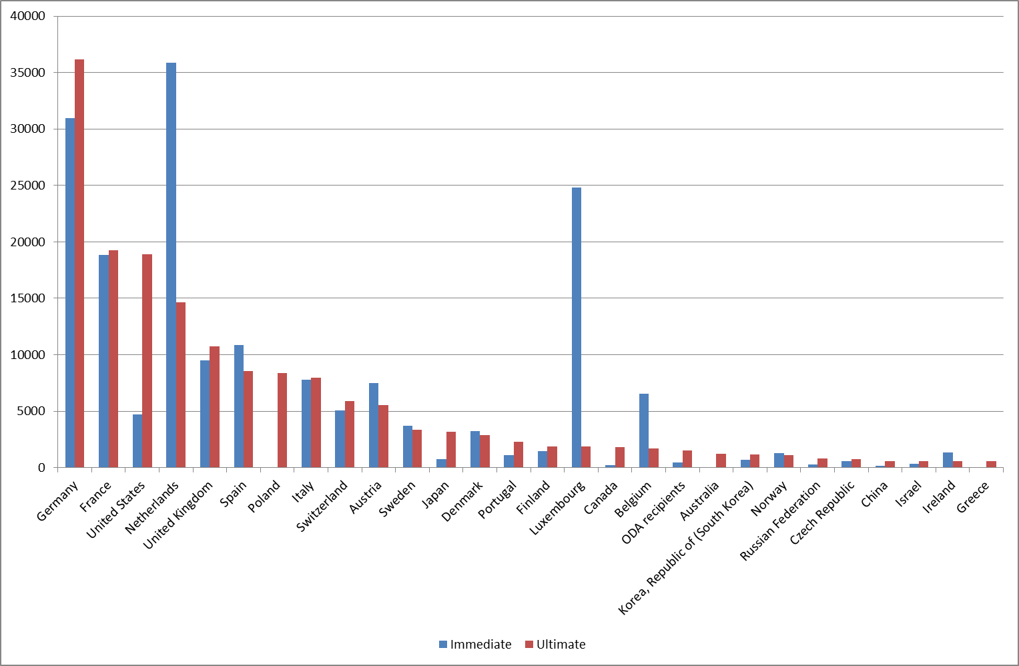
Immediate versus ultimate investors: Poland (2016, million USD, OECD)

